Slide 1
Purpose
What factors influence CMPD arrests?
Cleared Crimes
Measure and predict as binary classification
Survey of machine learning algorithms
Simple (CART, kNN, Naive Bayes)
Intermediate (SWR, Penalized GLM, SVM)
Advanced (GBM, Deep Learning, RF)

Slide 2
Data Overview
2012-2014 Crimes
Property, Person & Society Crimes
Incident Data (Lat/Long, Address, Time, Date, Type of Building)
Reported by, victim, property, weapon, victim relationship
Clear Rate
Four classes: Clear, Exceptional Clear, Open or Unfounded
Crime strategy
Feedback loop photo

Slide 3
Hypotheses & Methods
Type of Crime
Caught “Redhanded” or Not Present
Personal vs Property vs Society
Clues / Information
Witness present?
Public or private location?
Victim Age (child, early adult, adult, etc.)
Vulnerable witness (elderly, handicap, etc.)?
Time of Day (e.g. early AM)
“Nosy” neighbor correlations
Resources
Homicide vs petty crimes (CSS Search)
Victim – Business, Person, Gov't?
Wealthy Area (House Price, Income, etc.)?
Crime Waves?
Methods
Clean
Wrangle
Exploratory
Feature Generation
Feature Selection
Model Selection

Slide 4
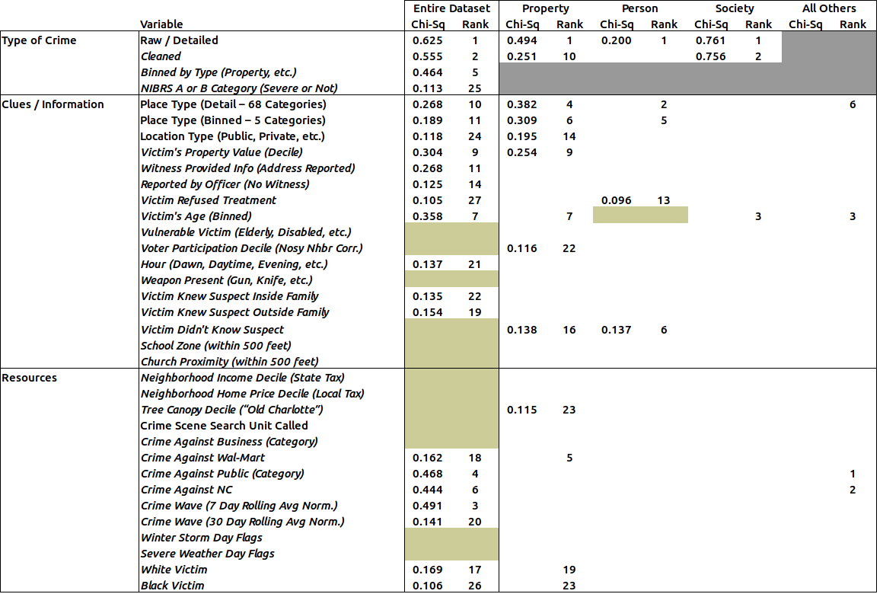
Feature Selection (Filter)
Table Plot

Slide 5
Property Crimes
Person Crimes
Society Crimes
All Other Crimes

Slide 6
Model Performance

Slide 7
Next Steps
Change Weights Based on Crime Severity
Higher weight towards severe crimes (homicides)
Multinomial Classification
Arrest versus Unfounded versus
Append evidence data
Rerun models to determine the value in evidence.
Identify items (evidence) that increase arrest.
Append Police Strategy data
Number of Detectives in each Unit / Division
Neighborhood watch units

